Slide 1





Removing Barriers to the Export of Farmed Shellfish from South Africa and Namibia
Funded by
Implemented by

Slide 2
WHO IS TFSA
Trade Forward Southern Africa (TFSA) is a programme under the Foreign, Commonwealth & Development Office (FCDO) of the UK Government, promoting trade in the SACU+M region.
Before government restructuring it sat with the Department for International Development (DFID).
Development Alternatives Incorporated (DAI) is the lead contractor for TFSA, covering the core implementation team and all sub-activities.
Imani Development is an implementing partner of DAI for the suite of aquaculture activities and other matters.

Slide 3
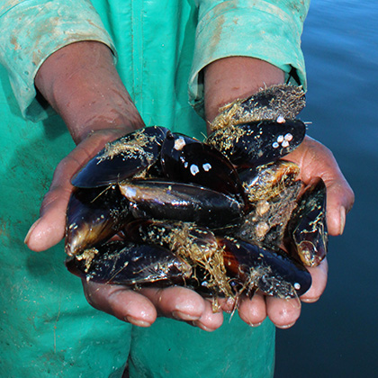
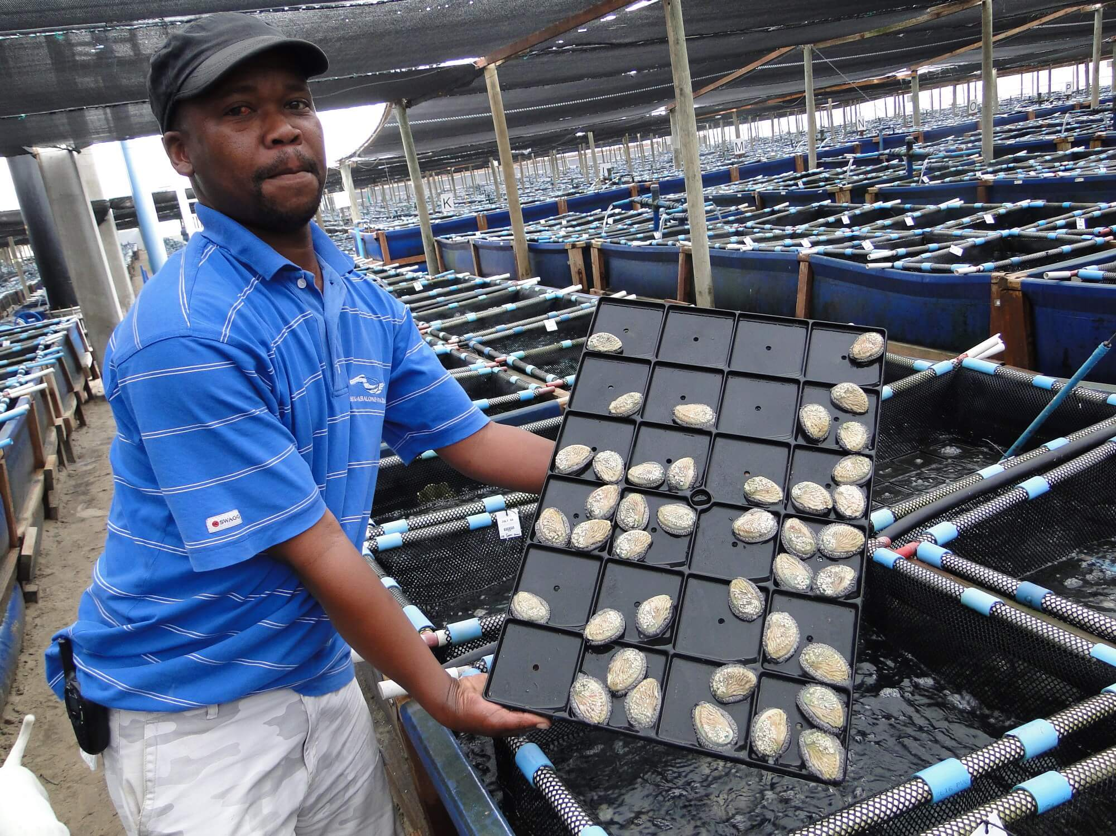
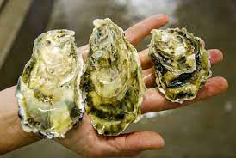
SOME SECTOR
BACKGROUND
South Africa farms:
Abalone - 1657 tons in 2019 (FAO)
Mediterranean Mussels - 3053 tons in 2019 (FAO)
Pacific Oysters – 383 tons in 2019 (FAO)
Namibia
Pacific Oysters - 351 tons in 2019 (FAO)

Slide 4
SECTOR (MARKET) CHALLENGES
Abalone is slow growing and are affected by marine conditions
Market for abalone in the Far-East is becoming competitive
Local markets for oysters and mussels are becoming saturated
Alternative market avenues are required

Slide 5
PROJECT PHASE 1 (2020)
Consider primary barriers to shellfish export form SA and Namibia to UK/EU
Uncertainty around laboratory capacity
Farmers would gain from a better understanding of the export requirements.
Gaps were identified in the required regulators controls by Competent Authorities

Slide 6
PROJECT PHASE 2 – IMPLEMENTATION (2021)
Developing a database of laboratories to document capabilities and capacities, with identification of any gaps.
Developing a compliance pack (guideline) for farmers – understanding the EU requirements
Development of a “compliance roadmap”

Slide 7

EU SANITARY REQUIREMENTS: APPLICABLE MEASURES
Requirement for “at least equivalent”
Regulation (EC) No 178/2002
Regulation (EU) 2017/625
General food safety of fishery products
Regulations (EC) No 852/2004
Regulations (EC) No 853/2004
Microbiological and marine biotoxin safety
Annex to Regulation (EC) No 853/2004
Commission Implementing Regulation (EU) 2019/627
Regulation (EU) 2021/405
Commission Delegated Regulation (EU) 2019/624
Commission Delegated Regulation (EU) 2019/625
Veterinary medicine monitoring and controls
COUNCIL DIRECTIVE 96/23/EC
Commission Decision 2011/163
Animal health
Regulation (EU) 2016/429
Regulation (EU) 2021/404
Certification
CIR 2019/2235
Regulation (EU) 2016/429
Regulation (EU) 2017/625

Slide 8
REQUIREMENTS FOR CERTIFICATION
MOL-HC OFFICIAL CERTIFICATION
Chapter 31 of Commission Implementing Regulation (EU) 2020/2235
Food Safety of fishery products
Veterinary drug residue monitoring of aquaculture products
Marine Biotoxins and Microbiological criteria for Bivalves
Aquatic Animal Health
Food safety and animal health requirements (all issues) expressed in a single certificate (since 2020)
Each system defined separately in EU legislation
Difficulty for third countries is that each system may fall under a different Competent Authority
Competent Authority must be exclusively responsible for official controls within each system (limited/conditional delegation)
Funded by
Implemented by

Slide 9
Compliance matrix (for human consumption)
Nature of product |  |  | Control system (Certification)
 | PRODUCT |  | Area controls for microbiology & marine biotoxins | Aquatic Animal Health | Veterinary medicine residues | Food safety & Env. contaminants
Feeding | Origin | State | DFFE | DALRRD? | DALRRD? | NRCS
 |  |  | MoFMR | MAWLR? | MAWLR? | NSI
Filter feeder (oyster & mussel) | Wild | Live | ☑ | ☑ |  | ☑
 |  | Processed | ☑ |  |  | ☑
 | Aquaculture | Live | ☑ | ☑ | ☑ | ☑
 |  | Processed | ☑ |  | ☑ | ☑
Non-filter feeder (Abalone) | Wild | Live | ☑* | ☑ |  | ☑
 |  | Processed | ☑* |  |  | ☑
 | Aquaculture | Live | ☑* | ☑ | ☑ | ☑
 |  | Processed | ☑* |  | ☑ | ☑
* Biotoxins only
Notes:
Not all of these controls are required for all products. ie. it is not a one size fits all control system
The area based microbiological classification, monitoring of plankton and marine biotoxins is only required in respect of bivalve molluscs.
Gastropod molluscs may be monitored for marine biotoxins at establishments.
Bivalves and gastropods which are harvested from the wild do not need to be subject to residue monitoring plan for residues of veterinary medicines.
Gastropods, live bivalves ready for retail sale and cooked or frozen bivalves do not need to come from areas subject to aquatic animal disease surveillance.
Live molluscs of all types require a veterinary inspection before certification and despatch.
The controls will need to be applied in a flexible way to match the product being exported to ensure that the attestation on the health certificate is true.

Slide 10
Current Compliance with EU control systems for fishery and aquaculture
General Food Safety and HACCP conditions for fishery products
In both RSA and Namibia official controls systems for general hygiene and food safety requirements for fishery products are already in place.
South Africa and Namibia have met the requirements for the export of fishery products in general to the EU, including hygiene and Hazard Analysis and Critical Control Points (HACCP) conditions for the approval of establishments.
However:
Neither country has met the conditions for:
Aquaculture (veterinary medicine controls and residue monitoring)
Live bivalve molluscs, echinoderms, tunicates, marine gastropods and products of animal origin from these animals intended for human consumption (microbiological and marine biotoxin monitoring)
Aquatic Animal Health Conditions
Notes:
Whilst a system is in place in both countries to guarantee the food safety of EU exports of fishery products in general, at present neither has met the conditions for:
controls on residues of veterinary medicines in aquaculture products and
food safety of filter feeding bivalve and gastropod molluscs;
aquatic animal health.
There is no official monitoring of veterinary residues in aquaculture products although such systems are in place for some other animal products and could be extended to aquaculture.
Shellfish monitoring programmes, whilst potentially technically valid, cannot be considered “at least equivalent” since the regulatory component of the control measures (e.g. area closure) are not fully reflected in law
The aquatic animal health measures to ensure control of some important transmissible diseases of shellfish remain to be developed and/or implemented, including diagnostic testing capacity, as well as the establishment of compartments based on disease status, and movement controls.
Each system has different requirements for its road map towards establishing the conditions which are “at least equivalent” to the EU legislation.
In each case, the map should be developed and adopted by a clearly nominated Competent Authority, which may be different in each case.
General food safety conditions for fishery products are established and fall under the CCA (the NRCS and NSI respectively).
A system of monitoring of marine biotoxins and microbiology of productions areas is developed in each country but does not have a sufficient regulatory foundation.
Systems for surveillance and control in relation to aquatic animal health and veterinary residue controls in aquaculture are not in place (they are developed for other products – mammals and birds – ostrich)

Slide 11
MARINE BIOTOXINS AND MICROBIOLOGICAL CRITERIA FOR BIVALVES
Nominate Competent Authorities for official controls of bivalve production areas and monitoring
Develop framework legislation to establish Competent Authority and mandate
Develop/update legislation related to Bivalve production
Develop procedural steps for:
Conduct Area classification
Define monitoring programmes
Define sampling and testing for each area
Sanitary surveys
Classification of areas (A,B,C)
Monitoring requirements
Closure of areas
Implement sanitary survey
Conduct sampling and testing field surveys
Define production and relaying areas
Nominate /delegate bodies in charge of monitoring progamme implementation
Create a laboratory network with testing capacities for programme implementation
Define reporting strategy and evaluate results
Establish notification procedures and follow up capacity for non-compliances
Specify area control system and classification criteria
Define control powers
Application to DG SANTE for approval and listing under Annex I of Regulation 2019/626
NB. May be limited in scope e.g. processed gastropods only
MOL-HC OFFICIAL CERTIFICATION
Develop a PRE-Certification scheme (in relation to Bivalve production requirements) to be delivered to the CA when applying consignments to be certified with official certificate MOL-HC (Chapter 31 of Commission Implementing Regulation (EU) 2020/2235)
Notes:
Current plans apply same conditions to “molluscan shellfish” products (bivalves and gastropod molluscs) whereas EU requirements are that gastropods, tunicates and holothurians which are not filter feeders do not have be subject to site survey and classification of harvest areas, providing that marine biotoxins are monitored at establishments. i.e. national plans go beyond EU requirements – additional burden
Current monitoring plans technically sufficient, but lack regulatory framework (and in Namibia labs were not performing well).
For processed abalone, OK for RSA (monitoring done at farm/factory).

Slide 12
VETERINARY DRUG RESIDUE MONITORING OF AQUACULTURE PRODUCTS
Nominate/agree Competent Authorities for veterinary medicine controls used in aquaculture
Develop framework legislation to establish Competent Authority and mandate
Develop/update legislation related to veterinary medicines
Authorisation, distribution and use for VM in aquaculture
Definition of banned substances and setting of MRLs
Design of Residue Monitoring Plan
Implement Residue Monitoring Plan
Establish official controls system(drug registration, distribution controls, monitoring)
Define implementation mechanisms
Delegation to technical institute for RMP implementation
Nominate laboratory(ies) with testing capacities for veterinary drug residues
Evaluate results
Follow-up non-compliances
Revise control procedures based ion findings
Design risk based sampling plan
Establish analytical protocols and action limits
Application to DG SANTE for RMP approval (Commission Decision 2011/163/EU) in accordance with Article 29 of Council Directive 96/23/EC
MOL-HC OFFICIAL CERTIFICATION
Develop a PRE-Certification scheme (in relation to Aquaculture production requirements) to be delivered to the CA when applying consignments to be certified with official certificate MOL-HC (Chapter 31 of Commission Implementing Regulation (EU) 2020/2235)
Notes:
Already in place RMPs for:
Crocs and ostrich in RSA (but labs not performing)
Bovine/sheep in Namibia (only part implemented, prohibited substances not outlawed – anabolics; and lab QC questionable

Slide 13
AQUATIC ANIMAL HEALTH
Nominate Competent Authorities for Aquatic Animal Health Controls
Develop framework legislation to establish Competent Authority and mandate
Develop/update legislation related to Aquatic animal transmissible diseases
List aquaculture diseases
Create Mechanisms for provision of Clinical inspection
Nominate diagnostic laboratories
Register and inspect farms
Design implement disease surveillance
Performed by an official veterinarian less than 72h before initiating transit
Establish official controls system(listed diseases, surveillance, compartments and movement controls)
Surveillance/ reporting
Obligations
Define disease free compartments
Establish surveillance mechanisms for AAH and Eradication programmes
Application to DG SANTE for Country listing under Regulation 2016/429
MOL-HC OFFICIAL CERTIFICATION
Develop a PRE-Certification scheme (in relation to AAH requirements) to be delivered to the CCA when applying consignments to be certified with official certificate MOL-HC (Chapter 31 of Commission Implementing Regulation (EU) 2020/2235)
Notes:
This is where the gaps are greatest, impacting on exports of live products
No implementation of OIE Aquatic Code in either country
No regulations
Notbiable diseases
Surveillance
Diagnotic Lab capacity
Control movement/eradication powers
Compartments (disease free zones)

Slide 14
RECOMMENDATIONS FOR SHELLFISH OPERATORS
Market review to determine the dimensions of EU demand for different products (production method/ species/ presentation)
Assess the business case for establishing the required sanitary control systems to meet EU requirements, considering i) public/private investment and ii) capital/operating costs
Prioritise development of control systems required
Request the different National Competent Authorities to establish control systems for prioritised products/sectors (the easiest and cheapest to establish in relation to the economic value of the trade flow).
Funded by
Implemented by
Notes:
Road map in each case will involve varying degrees of
development of new legislation,
building the capacity of Competent Authorities responsible for controls,
establishing competent testing laboratories and
investment by the operators in upgraded facilities and control systems
These substantial investments should be considered in the same way as any other, by firstly establishing the feasibility of the business case and plan, before committing to one particular path or another.
CAs:
RSA
aquatic animal health and veterinary residue controls (under the DALRRD)
monitoring of marine biotoxins and microbiology of productions areas (under DEFF)
NAMIBIA
aquatic animal health and veterinary residue controls (under the DVS of the MAWF)
monitoring of marine biotoxins and microbiology of productions areas (under MFMR)

Slide 15
RECOMMENDATIONS FOR COMPETENT AUTHORITIES (FISHERY PRODUCTS, MARINE ENVIRONMENTAL MONITORING, VETERINARY RESIDUES AND AQUATIC ANIMAL HEALTH)
Form a committee for the coordination of management of different sanitary risks and official controls in the shellfish sector.
Develop and adopt a prioritised and phased action plan reflecting the expressed export priorities of the sector, to extend the current controls for export of fishery products to include, progressively;
classification and monitoring of areas for the production of bivalves;
residue monitoring for products of aquaculture; and
aquatic animal health controls for live bivalve filter-feeding molluscs.
Consider the ease of establishing the controls when deciding the phasing of the action plan (filter feeders vs non-filter feeders and capture v. aquaculture production)
Account also for benefits of improved controls to South African consumers (in terms of safer products) and producers (with reduced risks and impact of disease outbreaks and improved AAH)
Ensure that all system requirements should be expressed in new or amended regulations (to meet EU requirements for equivalence)
Consider a system of pre-certifications to allow each CA to fulfil its mandate, whilst delegating final signature of the EU certificate to just one CA

Slide 16
SECONDARY PHASE
Deficiencies in skills around monitoring and identification of Harmful Algal Blooms

Slide 17

HARMFUL ALGAL BLOOM (HAB) TRAINING COURSE
Recognizing the worldwide need for skills, the Intergovernmental Oceanographic Commission (IOC) of the United Nations Educational, Scientific and Cultural Organization (UNESCO) launched the ’IOC Qualification in Identification and Enumeration of Harmful Microalgae’ in 1993.
This course is presented annually by the IOC Science and Communication Centre on Harmful Algae at the University of Copenhagen, Denmark.

Slide 18






THE TRAINING NEED
Abalone Farmer’s Association of South Africa (AFASA)
Bivalve Shellfish Farmer’s Association of South Africa (BSASA)
Namibian Mariculture Association
South African Food Safety Forum
South African Department of Forestry, Fisheries and Environment
South African National Regulator of Compulsory Standards
Namibian Ministry of Fisheries and Marine Resources

Slide 19

SECTOR BENEFITS
Internationally recognized personnel in HAB monitoring programme.
Credibility of monitoring programme.
Meeting of international food safety standards
Safer products.
Commercial advantages around product sourcing.

Slide 20
DISSEMINATION AND CONCLUSION
Sector Workshop
Session though Aquaculture Africa Magazine
Presenting a Paper at AFRAQ2021
Presenting a paper at AASA2021

